Slide 1


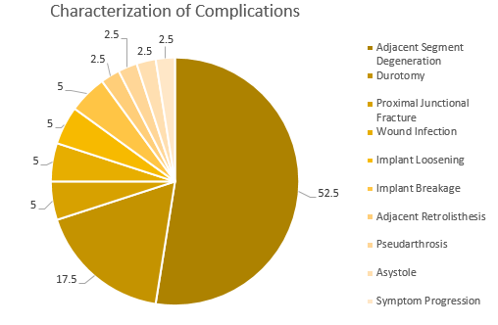
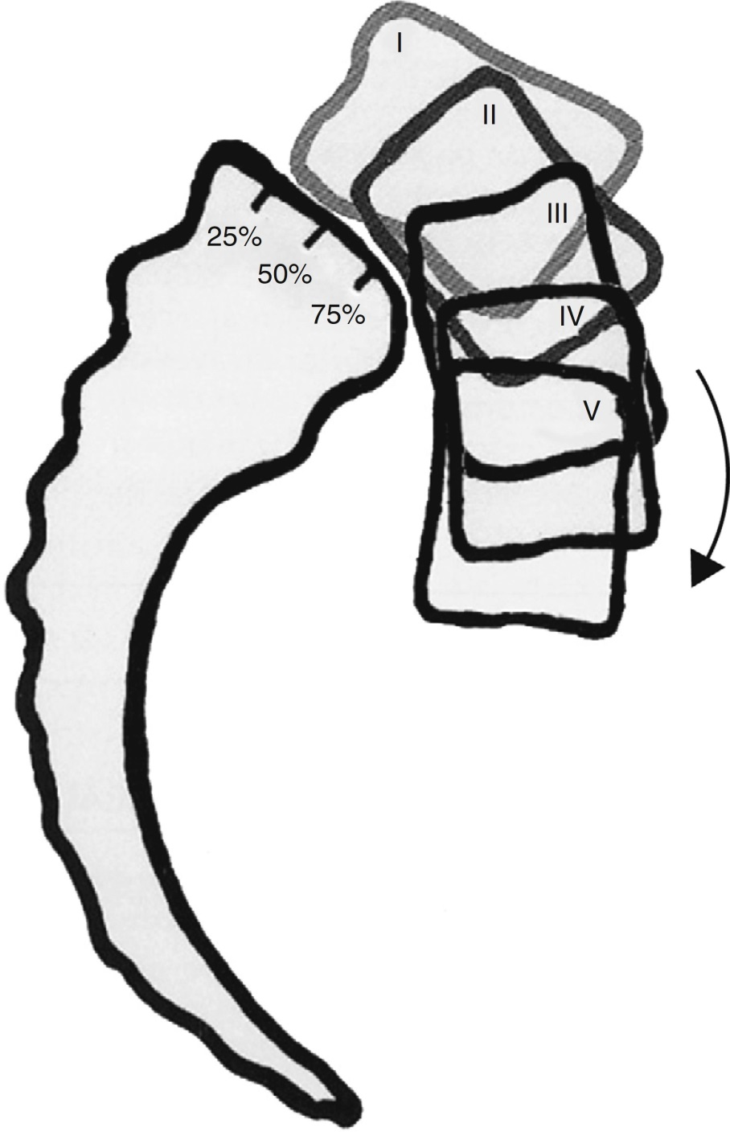
Title in sentence case or Title in Title Case
First Last Name, Credentials, First Last Name, Credentials
Introduction and Purpose
Results and Discussion
Sample text sample text sample text sample text sample text sample text sample text sample text sample text sample text sample text sample text sample text
Sample text sample text sample text sample text sample text sample text sample text
Sample text sample text sample text sample text sample text sample text sample text sample text sample text sample text sample text sample text sample text
Table 1. Demographics of Final Cohort
Demographic |  | N | %
Sex | Males Females | 45 59 | 43.3 56.7
Race | White Black Hispanic Asian | 94 7 2 1 | 90.4 6.7 1.9 1.0
Age | <40 41-50 51-60 >61 | 18 30 26 30 | 17.3 28.8 25.0 28.8
Spondylolisthesis | Isthmic Degenerative Other | 22 46 36 | 21.2 44.2 34.6
Table 2. Radiographic and Surgical Parameters
Variable |  | N [%]
No. of Levels | One Two | 72 [69] 32 [31]
Pre-Op Meyerding | Grade I Grade II Grade III Grade IV | 58 [55.8] 41 [39.4] 4 [3.9] 1 [1.0]
Post-Op Meyerding | Grade 0 Grade I Grade II Grade III Grade IV | 29 [27.9] 55 [52.9] 16 [15.4] 3 [2.9] 1 [1.0]
Meyerding Δ | 0 Grade 1 Grade | 48 [46.2] 56 [53.8]
Methods
Sample text sample text sample text sample text sample text sample text sample text sample text sample text sample text sample text sample text sample text
Sample text sample text sample text sample text sample text sample text sample text
Sample text sample text sample text sample text sample text sample text sample text sample text sample text sample text sample text sample text sample text
Sample text sample text sample text sample text sample text sample text sample text sample text sample text sample text sample text sample text sample text Sample text sample text sample text sample text sample text sample text sample text sample text sample text sample text sample text sample text sample text
Figure 1. Meyerding Grading
Conclusions
Sample text sample text sample text sample text sample text sample text sample text sample text sample text sample text sample text sample text sample text

